Slide 1
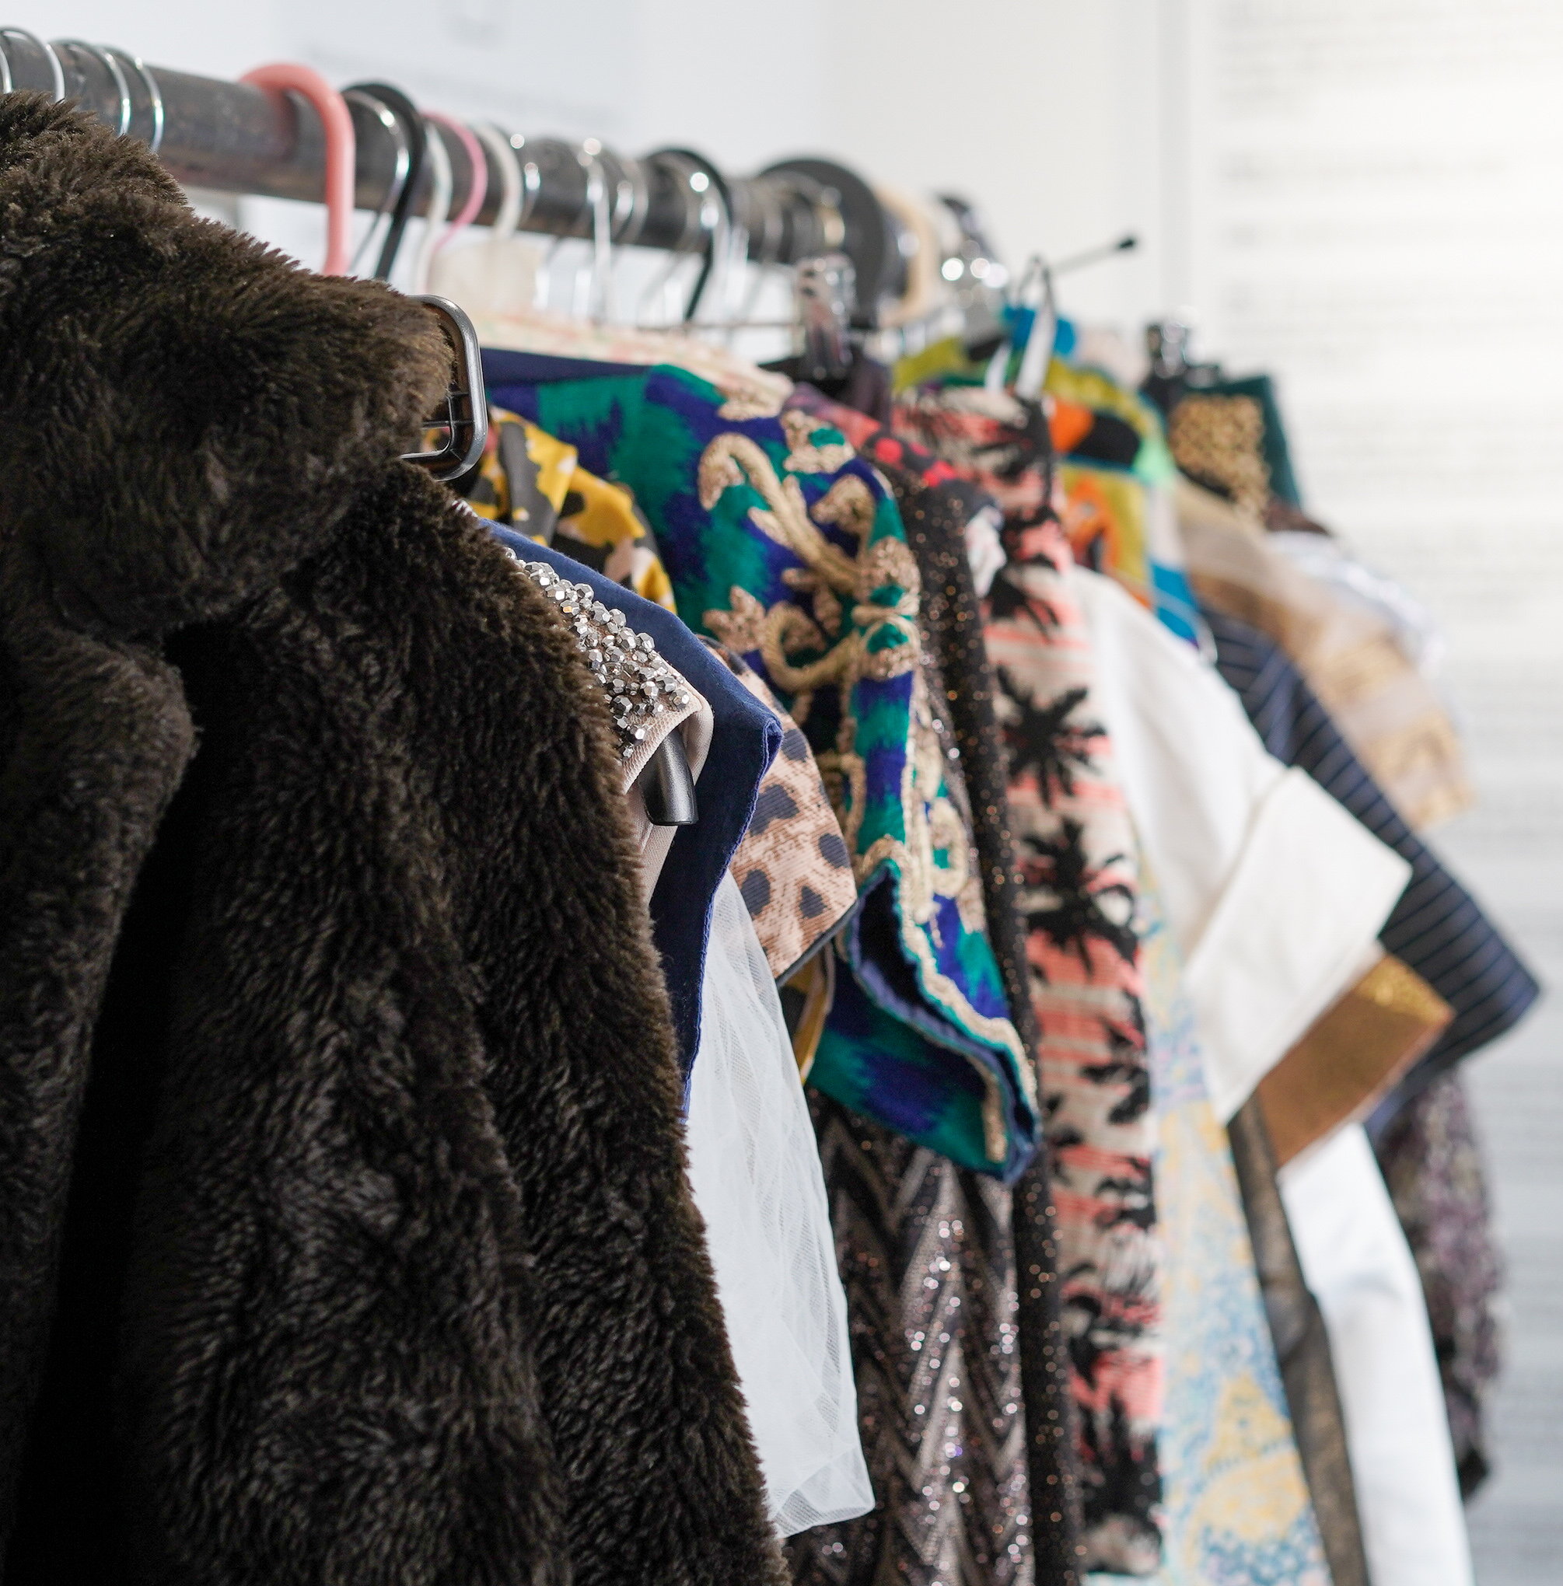
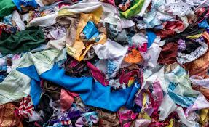
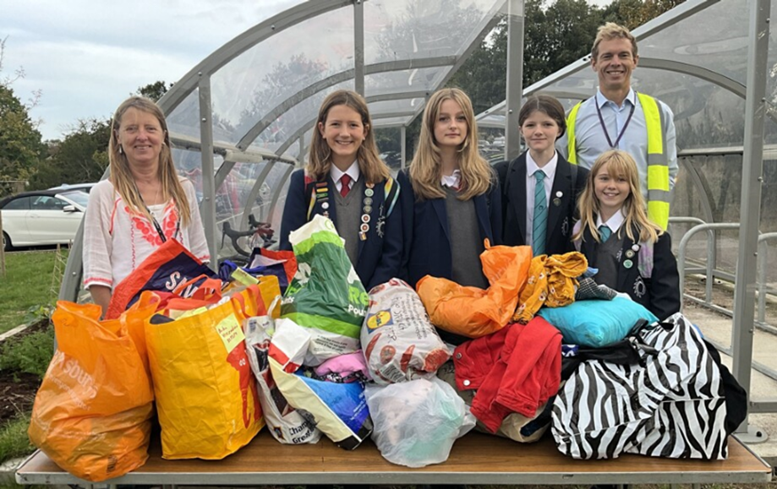
Run Your Own School Clothes Swap
Did You Know...
• The fashion industry produces about 10% of annual global carbon emissions – more than all international flights
• Textile production also uses a lot of water – eg over 7.5 thousand litres of water are needed to make one pair of jeans
• Teenagers are the biggest consumers of clothes. On average clothes are only worn 7 times before being discarded
• Most textile waste goes to landfill – less than 1% of clothes are recycled
You will need:
• A large room / hall with changing facilities nearby
• Around 4 x clothes rails and approx. 200 coathangers – these can be hired from Gladrags if you don’t have access to them within your school community. Coathangers with clips for hanging trousers are particularly useful
• 3 x tables (one for small items, one for signing in, one for signing out)
• 2 x long mirrors
• Raffle tickets
• Pens and paper for posters
• Clothing sign in and out sheets and pens - provided
• Clothes grading system - provided
2-3 weeks before the event:
• Recruit a team of 6-10 students to help run and publicise event. Textile students and those involved with sustainability are ideal. Photography students may help document the event.
• Design poster –include event date, drop off date and point, venue and timings
• Sort logistics – venue, hangers and rails, drop off point
1 week before the event
• Put up posters around school
• Publicise in tutor groups – you may want to show part of the short film on the website. Alternatively use the 'Did You Know' facts above
This guide was created following a pilot event led by Sew Fabulous + Our City Our World at Varndean + Dorothy Stringer schools

Slide 2
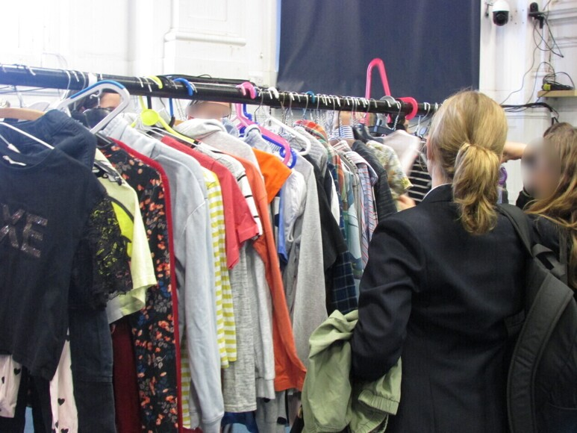
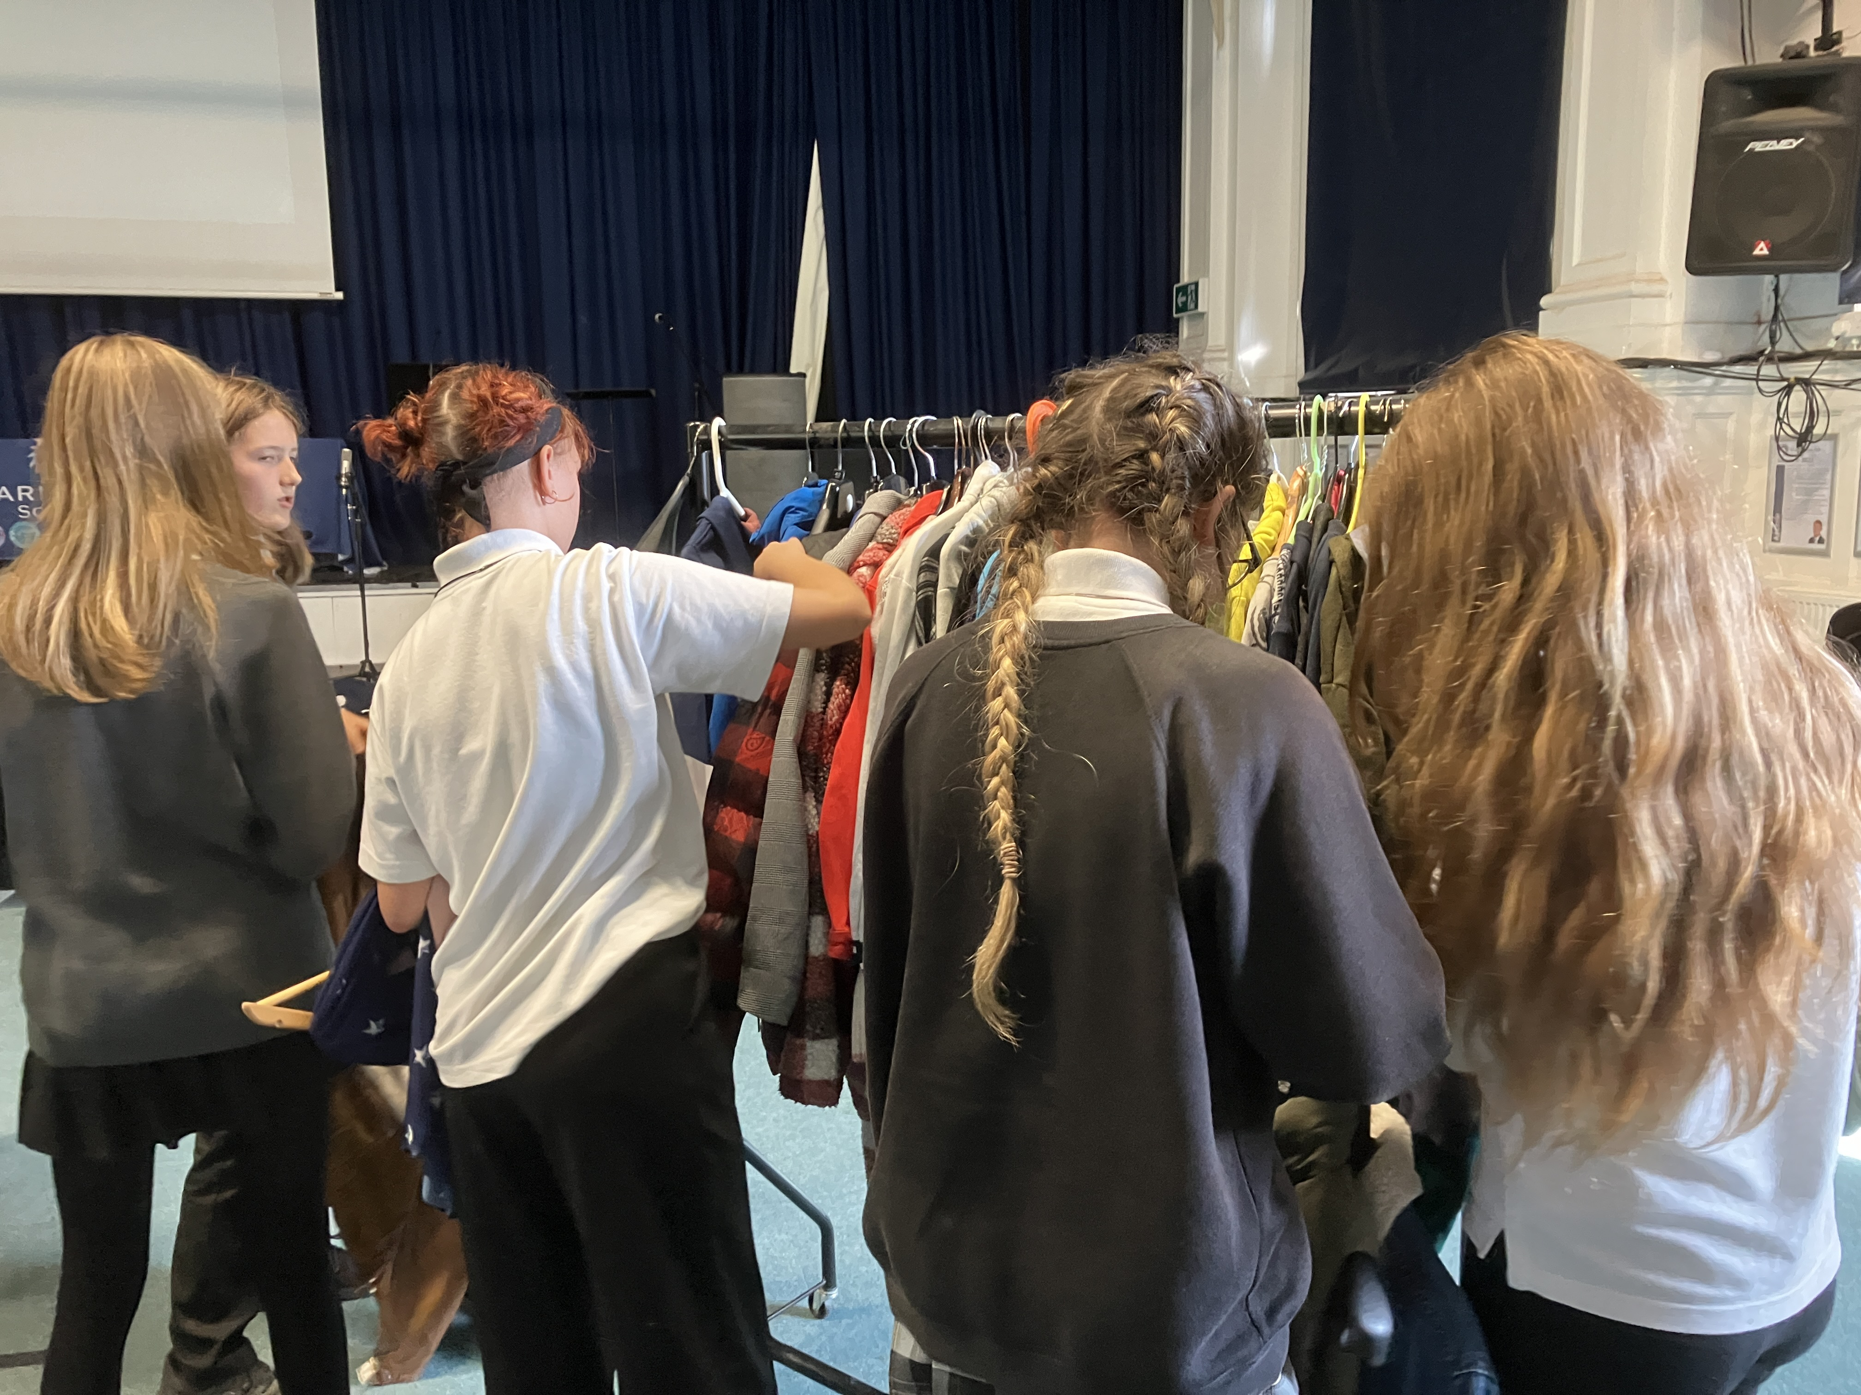
On the day
• Allocate drop off point and time and ensure someone is there to check all bags are named
• Set up - this took approximately 1.5 hours with a team of 10 students
• Set up room with rails, table for small items and 'In' and 'Out' table at entrance
• Open each bag. Reject any poor quality items. Allocate tickets using grading system - provided
• Record the number of tickets for each person on a list at the entrance. It may be useful to put allocated tickets in a named envelope before the event.
• Itemise all items collected on a tally sheet – provided
• Hang clothes in categories eg tops, trousers, coats, skirts
• Create and hang posters detailing ticketing system and identifying changing room
During the event
• Play music
• Students enter and collect their allocated tickets from the entrance table
• Once they have chosen new items, they swap these items for their tickets
• Tally the items taken in order to work out the impact of your event
After the event
• Keep left over clothes for next event or redistribute at charity shop, clothes bank or Care 4 Calais collection
• Publicise number of items of clothing
re-used because of the event and work out carbon savings using the formula on the tally sheet
• Plan your next event!
Things to consider
• Is the event inclusive – can you allocate ‘free’ tickets to those on FSM?
• Can you theme your events – eg autumn/winter clothes or spring/summer clothes?
• Do you have enough clothes for taller / larger people? There is a tendency to donate smaller clothes.
• Is there a way of encouraging more boys to get involved eg by promoting donation of sportswear / equipment?
• Reinforce beforehand that only clean, good quality clothes will be allocated tickets. You don’t want to be left with lots of old items
• What about a catwalk? Could you include a fashion show as part of the event?
• What about running a staff clothes or a prom dress swap?

Slide 3
Token Exchange Guide
This is a suggested system for grading clothing to allocate tokens at the start or 'buy' from tokens at the end.
Item | Tokens
Small Accessory (i.e., scarf, belt, bags) | 1
T- shirts, Vests | 2
Simple Dress, Light Jacket, Skirts, Shorts, Trousers | 3
Jumper, Knitwear, Jumpsuits, Amazing Skirt, Fashioned Dress | 4
Amazing Coat or Dress (i.e. Winter, Funky) | 5
Sew Fabulous is a not for profit sustainable community textiles studio based in Brighton Open Market. They design and deliver classes, courses, workshops and events and produce the first Brighton Sustainable Fashion Week alongside our partners Brighton Peace and Environment Centre in October 2023
Our City Our World is the sustainability, climate change and environmental education programme for Brighton & Hove schools

Slide 4
Tally chart to record number of items donated
Garment | Donated | Total
Tops
Shirts
Vests
Trousers
Shorts
Skirts
Jumper
Knitwear
Simple Dress
Fashioned Dress (i.e., Sequin)
Jumpsuits / Dungarees
Jacket
Coat
Small Accessory (i.e., scarf, belt, bags)
Carbon Savings: 3kg CO2 produced for every medium or high quality item swapped.
Also significant water savings made for every item swapped.

